Slide 1
Nodes and Scenes
Mack 2023

Slide 2
Learning Objectives
Understand the concept of nodes in Godot and their importance in game development.
Learn how to create and modify nodes in the Godot Engine.
Understand the concept of scenes and how they are used in Godot.
Learn how to create and use scenes in the Godot Engine.
Understand how to duplicate nodes and change their properties.
Learn how to save nodes as scenes and use them in other scenes.
Understand how to add child nodes to a scene and modify their properties.

Slide 3
Nodes and Scenes
In this lesson, we will be covering the concepts of nodes and scenes inside Godot. In a Godot game, everything is made up of nodes, like how everything in the real world is made up of atoms. Everything that has a position in space or any other logic behind it will be part of a node, so they are an important thing to understand for game development inside the Godot Engine.

Slide 4
What is a Node?
A node is a fundamental element in Godot.
Everything in a Godot project, such as the player, enemies, environments, lights, backgrounds, and camera, is made up of nodes.
Nodes can have children nodes, which can have children nodes, and so on. This creates a hierarchy of nodes, which is the basis of a Godot game.
In the Scene window, we already have one node which we created previously, our Node2D that acts as our scene root.
The root node is essentially the utmost node in a scene – it is at the top of the hierarchy, and everything attached to it will build up our scene.

Slide 5
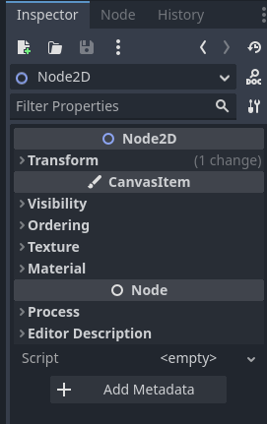
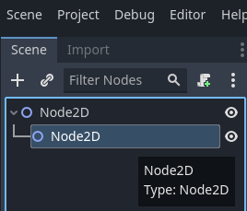
What is a Node?
If you select the Node2D node, you will see some options appear in the Inspector window. These allow you to modify the values of the node that you have selected, such as its transform. Since our Node2D is a root node it is best to leave the values as their defaults.

Slide 6
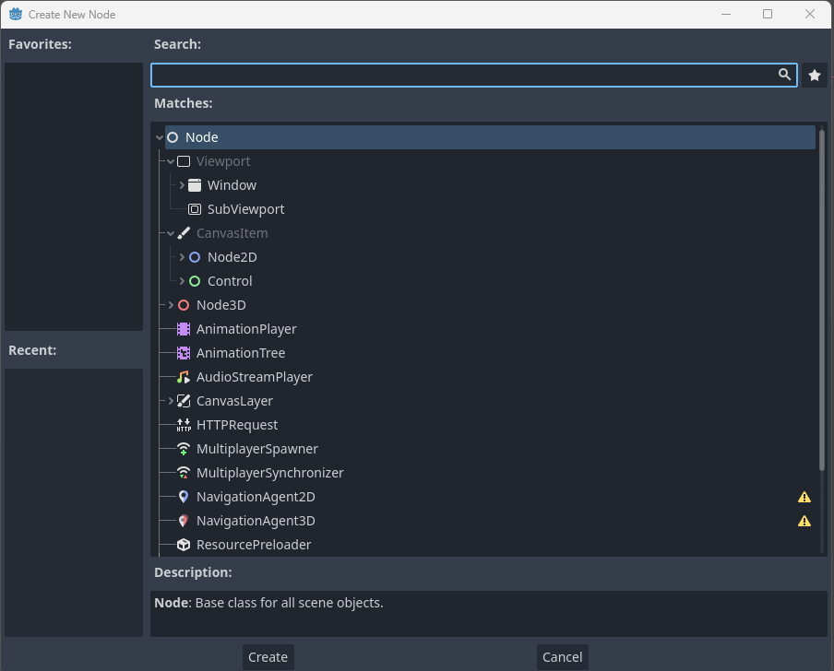
What is a Node?
Instead of modifying the root node, we can add a new node to the scene by pressing plus button at the top left corner of the Scene window.

Slide 7
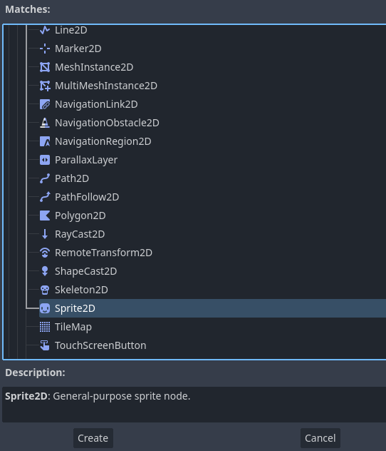
What is a Node?
This will open the Create New Node window, which contains a list of nodes that can be chosen from. The list is divided into 2D and 3D sections, and each type has its own list of nodes.
Under the Node2D section, you find the Sprite2D node, which you can double-click to create (or use the Create button).

Slide 8
What is a Node?
The Sprite2D node is a general-purpose node used for displaying sprites, as per the Description.
You will notice the new Sprite2D is added as a child of the root node.
Nodes inherit their position, rotation, and scale from their parent node, so if you move the Node2D root node, it will also move the Sprite2D by the same distance.
Nodes can effectively have an infinite number of children, and each child can have an infinite number, and so on.

Slide 9
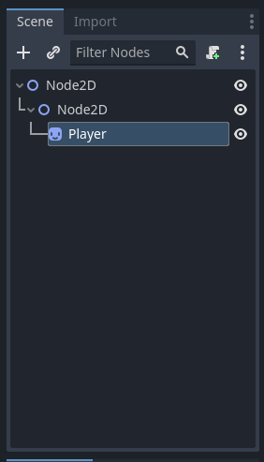
What is a Node?
We can rename the sprite by double-clicking, to help with project organization. We will rename ours to Player.

Slide 10
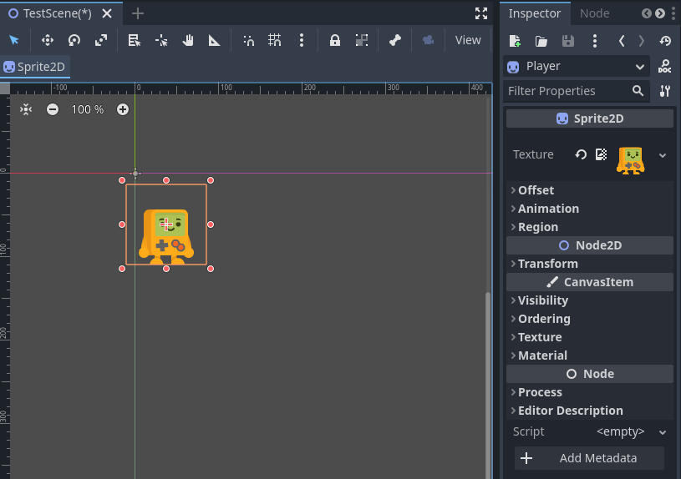
What is a Node?
A Sprite2D node is used to render a 2D texture to the screen.
To do this we first need to set the Texture property of the Player node.
By default, it says <empty> which means no value has been assigned.
You can drag the Player.png file (found in the FileSystem) into the property field to set it as the Texture.
Notes:
This will make our player appear in the Scene Viewport.

Slide 11
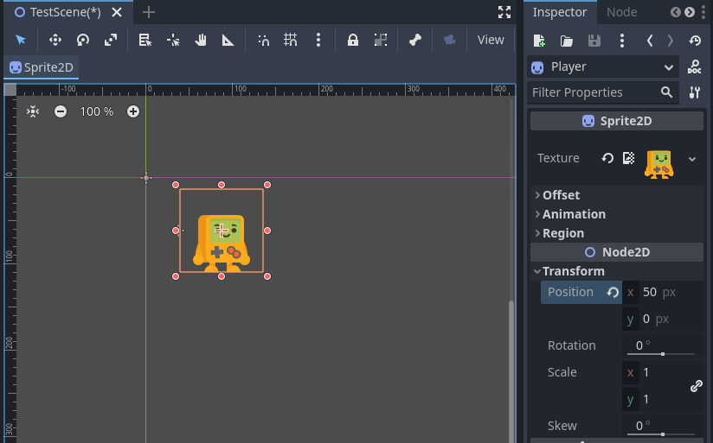
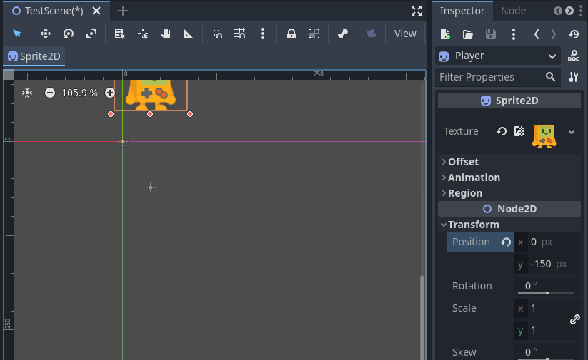
What is a Node?
In the Transform property, found in the Inspector window, you can modify the position, rotation, and scale of the Player sprite.
If you change any of the values you will notice they update inside the Viewport window.
For example, setting the position to (50, 0) will move it 50 pixels to the right.
On the other hand, setting the position to (-150, 0) will move it 150 pixels to the left of the center of the graph.

Slide 12
What is a Scene?
We mentioned scenes multiple times above, they are collections of nodes that can be instanced at any time.
For example, levels in a game can be their own scene, and the player can be a scene that is instanced in multiple levels. Enemies can also be saved as a scene and spawned in multiple times.
Now that we know how to create nodes, we are going to take a deeper look into the concept of scenes. Currently in our TestScene level is a Player node, but we might also want multiple other objects, such as rocks, trees, or enemies.

Slide 13
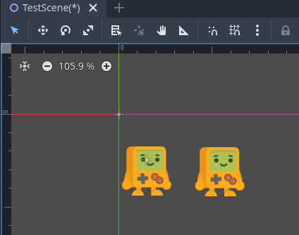
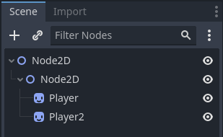
Duplicating Nodes
We can start by duplicating the Player node we created in the last lesson.
To do this, select the node and press CTRL+D to duplicate the player.
Alternatively, right-click the node and select Duplicate. This will create a second version of our player in the scene.

Slide 14
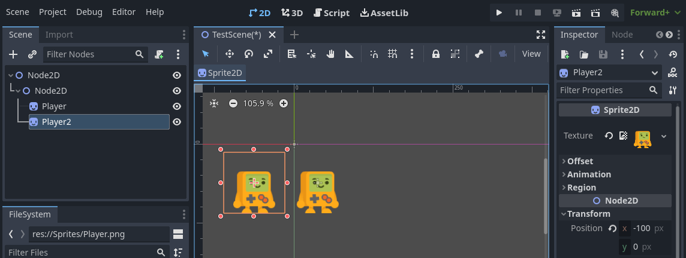
Changing Node Properties
With our Player2 duplicate node selected, we can then change its position to differentiate it from the original node. We will change the position to be around (-100, 0).

Slide 15
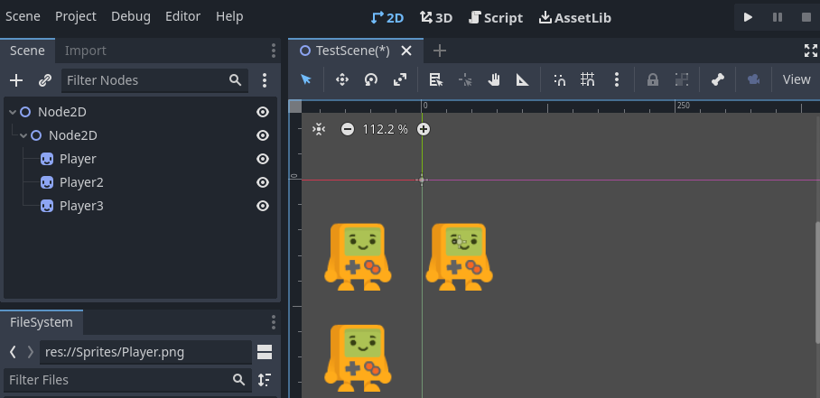
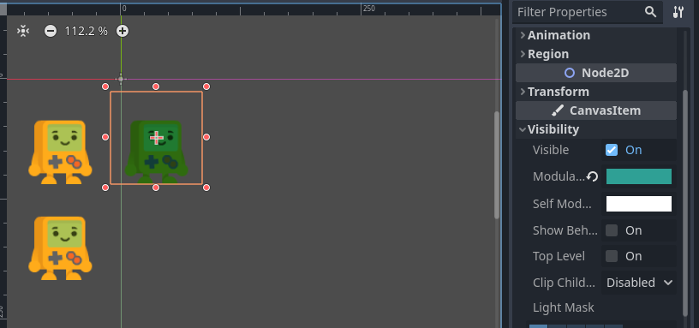
Changing Node Properties
We can then duplicate the node again to create 3 player nodes and change its position to something else, for example (-100, 100).
Now we have 3 duplicates of our Player in our test scene, if we select the original Player node, we can change the color by changing the Modulate value, underneath the Visibility dropdown.
Notes:
However, if we want to apply this to every version of the player we have to go through and do it individually, which would take a lot of time. Instead, what we will do is turn our player node into a scene.

Slide 16
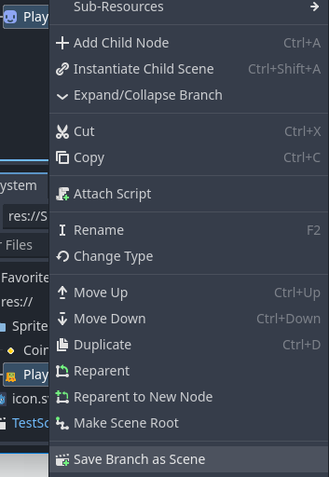
Creating a Scene
To begin with, delete the duplicate nodes, as we will not be using them.
Then, select our Player node and right-click it, then press Save Branch as Scene.
In the pop-up window, name the scene Player.tscn and press Save.

Slide 17
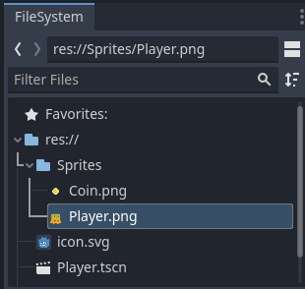
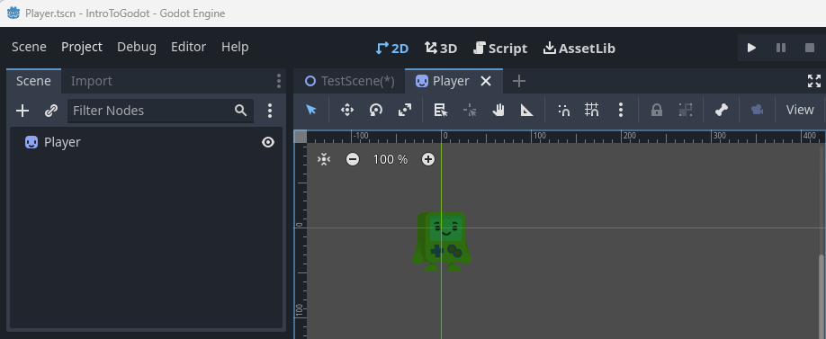
Creating a Scene
You’ll now be able to see our Player.tscn scene inside the FileSystem window.
If you now double-click the Player.tscn scene, it will open it in a new scene window.

Slide 18
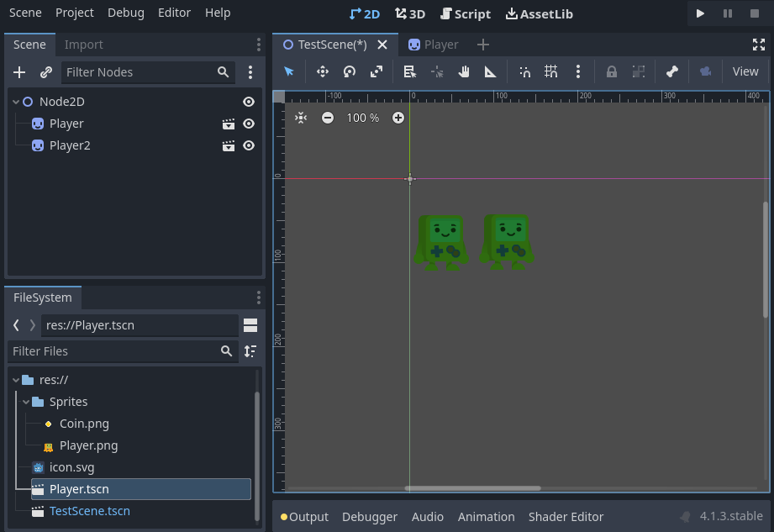
Creating a Scene
Return to the TestScene if you opened the Player window by pressing the TestScene tab.
We can then drag the Player.tscn scene into our TestScene level to create another instance of it.
You can do this as many times as you like, to make as many Player nodes as you want

Slide 19
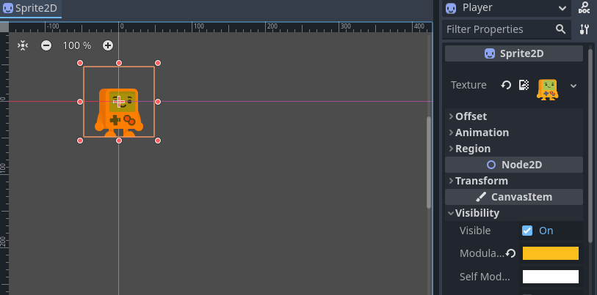
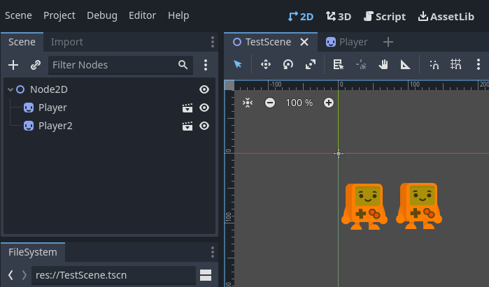
Creating a Scene
Now, if we want to change the color this time, we can do it by editing the Player Scene. With the Player scene open, change the Modulate value to a new color.
Then save the scene (CTRL+S) and return to the TestScene.
You will now see that every instance of the Player scene is the color we assigned in the original scene.

Slide 20
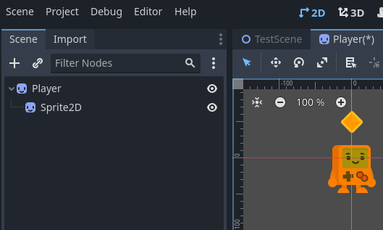
Creating a Scene
We can also add nodes to our scenes, so in the Player Scene, right-click the root node and press Add Child Node.
We will add another Sprite2D node to the scene.
This time, we will set the Texture property to be our Coin.png texture.
We will the coin above the Player sprite’s head by setting the Position property to (0, -50).

Slide 21
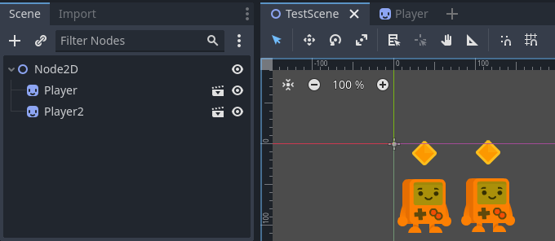
Creating a Scene
Save the scene and return to the TestScene and you will see the coin appears above every instance of the player, as expected.

